Slide 1


Investing with Fast Thinking
Authors: Li Liao, Zhengwei Wang, Jia Xiang, Hongjun Yan, Jun Yang
Presented by: Yang Ju
Instructor: Philip Dybvig

Slide 2
Objective
How fast thinking affects investment decisions in real financial market?
How do investors make financial decisions with fast thinking?
Are the decisi0ns cost-efficient, near optimal or systematic errors?
What are the factors that shape the decision rules?

Slide 3
Fast Thinking
System 1:
  Operates automatically, quickly, with little or no effort
  May lead to systematic mistake
  “Fast Thinking”
System 2:
  Slow and deliberate
  Allocates attention to effortful mental activities

Slide 4

Renren Dai
Online peer-to-peer (P2P) lending platform
Bidding on unsecured microloans listed by borrowers
Leading P2P company in China

Slide 6
Findings
“Investors focus on loans with high interest rates, disregarding information on credit ratings”
Three factors:
  Time pressure
  Salience
  Firsthand experience

Slide 7
Procedure
Hypothesize
  Under time pressure, investor’s attention focuses on interest rate; disregard other important information, such as credit ratings
Support:
  1. Renren Dai’s principle guarantee mechanism
    Repay investor’s principle if default occurs
  2. Interest rate’s prominent location on the platform

Slide 8
Data Findings
Sample Contains:
  10,385 loans
  205,724 investments
  25,314 unique investors
Findings:
  71.2% (HR) loans
  87.3% male borrowers
  Average age of 32.9
  55.5% of homeowners
  21.7% with mortgage

Slide 9
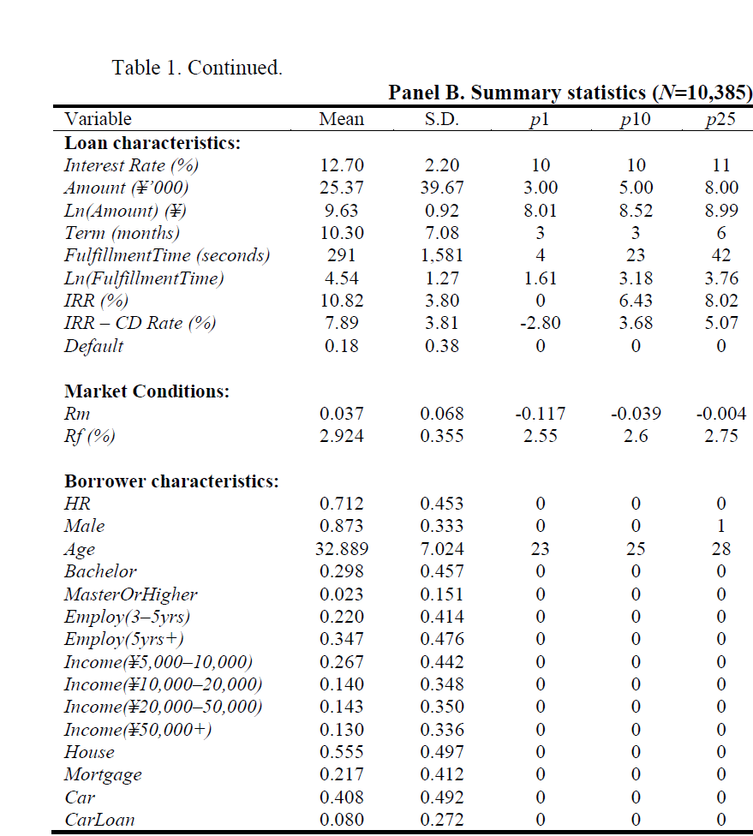

Slide 10
Fast loans vs. others
Fast Loans
Others
Term: 10.57 months
Amount: 13,873
Age: 31.31
Default rate: 19.8%
Interest rate: 13.71%
10.21 months
29,299
33.43
16.7%
12.36%

Slide 11
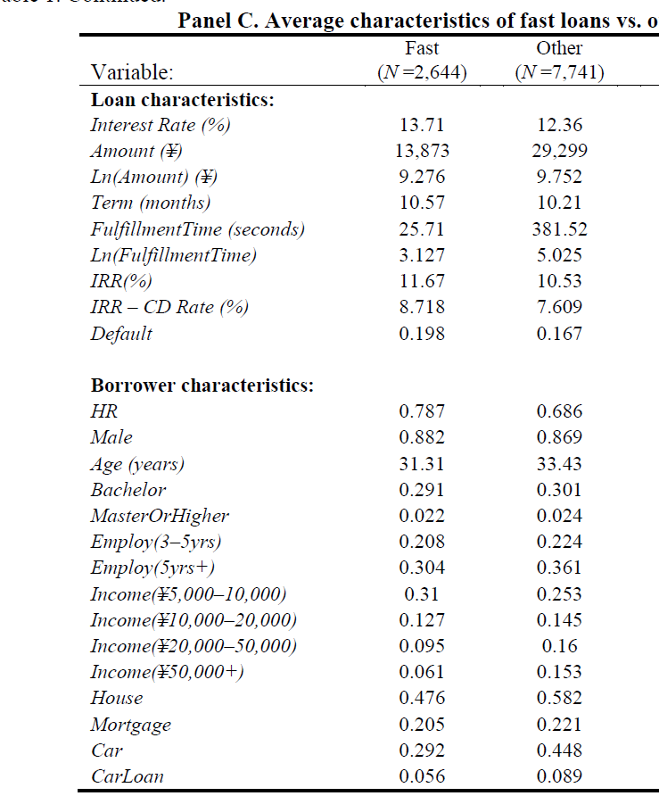

Slide 12
Primacy of Interest rate
Whether decision speed depends on interest rate
  OLS regression of Fulfillment time on Interest rate and HR(High risk)
  Interest rate: -0.206
  t-statistic: >19
  1 SD increase in Interest rate (2.2%) decreases Fulfillment time by 36%
Other findings (funded quickly):
  Borrower with graduate degree
  Monthly income between 5,000-10,000
  Own a house

Slide 13
Time Pressure
Empirical Evidence:
  Fulfillment Time is more sensitive to interest rate
  Investors rely more on fast thinking; thus more responsive to interest rate
Experimental Evidence:
  36 (treatment) vs. 36 (control)
  Training Session and 30 mins to study 50 loan
  Decision Time: Treatment (42s) vs. Control(180s)
  Survey Questions

Slide 14
Time Pressure Results
Treatment Group
Control Group
Chose loans based primarily on interest rates
Rely more on intuition
Interest rate as most important: 47%
Credit rating: 19%
Intuition Score: 4.81
On interest rate, as well as credit ratings and etc.
Less on intuition
17%
44%
3.72

Slide 15
Salience
Empirical Evidence:
  Mobile interface further encourage investors make decision based on interest rate
  Panel Regression: mobile bidders are 13.5% faster than PC bidders
Experimental Evidence:
  Modified mobile app interface
  3 groups
  Survey Questions

Slide 16
Salience Results:
With more visible information, investors slow down decision process and incorporate the additional info. Into their decisions
Group 1:
  Interest rate as most important: 39%
  Credit risk as most important: 23%
Group 2:
  19%
  35%
Group 3:
  26%
  47%

Slide 17
Firsthand Experience
Empirical Evidence:
  Additional loan investment experience increase decision time by 1 second
  After experiencing default, investors take 80s more to make decisions
  3.1% Less likely to choose HR loans with recent default
  28 basis points increase in return annually
Experimental Evidence:
  34(treatment) vs. 34(control)
  Same training
  2 rounds of loan picking

Slide 18
Firsthand Experience Results
Group 1 (control)
  Interest rate as most important: 50%
  Credit rating as most important: 34%
Group 2(treatment)
  23.53%
  45%

Slide 19
Conclusion
Investor’s attention focuses on interest rate; disregard other important information, such as credit rating
Three important factors:
  Time pressure
  salience of the information
  firsthand experience
“Under Time Pressure, decisions that focus on the most important factors can be near-optimal strategies”

Slide 20
Any Questions?

